Slide 1
Deep Learning: Practical Applications
Mike Kurland and Pooja Singh, GDIT Digital Consulting, Data and Analytics
October 19, 2019

Slide 2

Diverse and Talented Workforce
ABOUT GDIT
35K+
EMPLOYEES
14K+
TECHNOLOGISTS
8K+
VETERANS
We are GDIT. The people supporting and securing some of the most complex government, defense and intelligence projects across the country. We deliver. Bringing the expertise needed to understand and advance critical missions. We transform. Shifting the ways clients invest in, integrate and innovate technology solutions.
We ensure today is safe and tomorrow is smarter. We are there. On the ground, beside our clients, in the lab, and everywhere in between, offering the technology transformations, strategy, and mission services needed to get the job done.
Global Operations
400
CUSTOMER LOCATIONS
270
FACILITIES
30
COUNTRIES
Experience
50+
YEARS OF SERVICE
90+
ALLIANCE PARTNERS
STRATEGY TECHNOLOGY MISSION SERVICES
WHO WE SERVE
Defense
Health
Federal Civilian
Intelligence Community
State
National Security

Slide 3
Deep Learning: Practical Applications Today’s Discussion
What is Deep Learning?
The Perfect Storm for Deep Learning
Deep Learning Applications
Demonstration

Slide 4
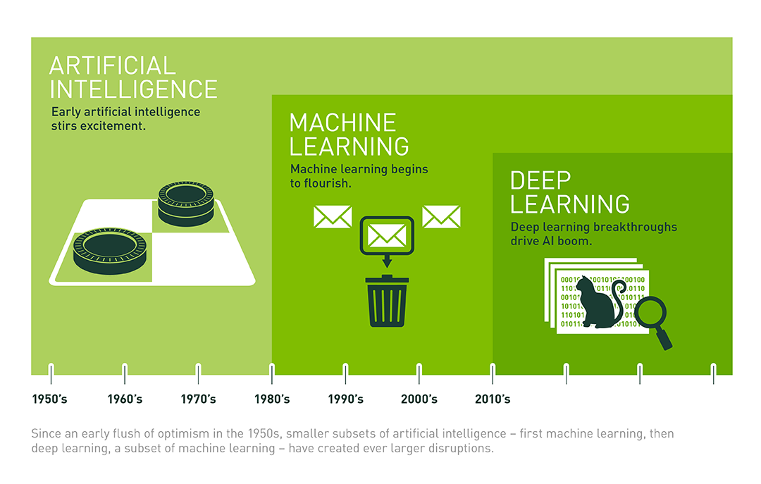
What is Deep Learning?
Sourced from NVIDIA blog
Reduces need for feature engineering
Generalize more readily and tolerate noisy data
Higher accuracy
The Deep Learning Subset of Artificial Intelligence and Machine Learning Employs Neural Nets with Multiple Hidden Layers to Improve Machine Learning Accuracy, Now Beyond Human Capabilities

Slide 5

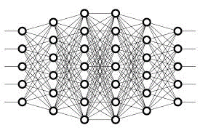
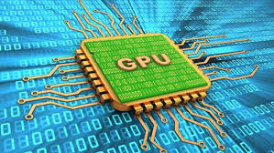
The Perfect Storm for Deep Learning
Explosion
of data
Rapid Progress
of research and open source applications of neural networks
Artificial Intelligence now is spreading outside of research into everyday activities and operations
GPUs and Cloud
Overcome computational constraints

Slide 6





Beyond Games: Practical Applications for Deep Learning
Fraud detection
Image recognition
NLP, e.g. Translation, finding relevant documents
Yield and operational optimization
Predictive Maintenance
Recommendation engines, chatbots
How can we make the bulk of operational decisions without human help?

Slide 7
Public Sector Deep Learning Use Cases
Fraud Detection
Benefits, Tax, Health Care
Public Health
Bio-Surveillance
Disease Diagnosis
Epidemiology
Research, Disease Management
Risk Assessments
Hazardous Spill Classification
Dangerous Image Recognition
Airport and Traveler Risk
Financial Analytics
Budget Forecasting
Benefits and Subsidy Forecast
Grants Management
Veterans
Veterans Benefits Analysis
Workforce Forecasting
Suicide Prevention
Defense and Intelligence
Mission, Readiness, Financial, Personnel

Slide 8
Demonstration

